Slide 1
Functions in c

Slide 2
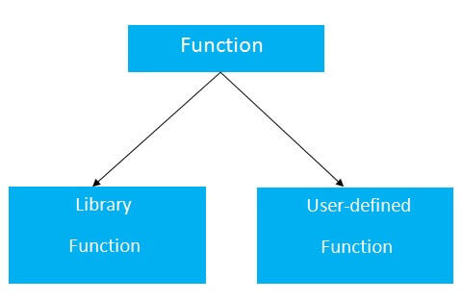
function
A function in C is a set of statements that when called perform some specific task. It is the basic building block of a C program that provides modularity and code reusability. The programming statements of a function are enclosed within { } braces, having certain meanings and performing certain operations.
Syntax of Functions in C
The syntax of function can be divided into 3 aspects:
Function Declaration
Function Definition
Function Calls

Slide 4
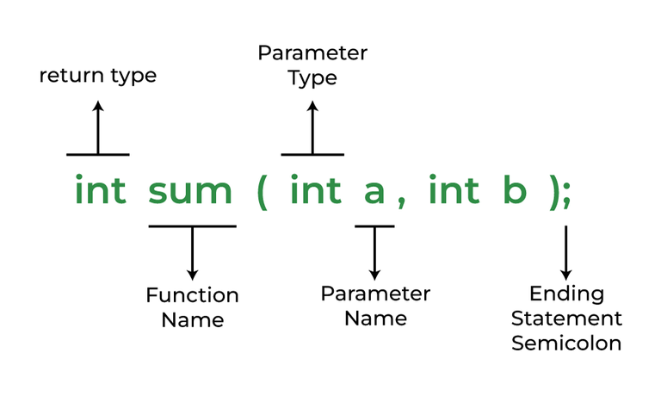
Function Declarations
In a function declaration, we must provide the function name, its return type, and the number and type of its parameters. A function declaration tells the compiler that there is a function with the given name defined somewhere else in the program.
Syntax
return_type name_of_the_function (parameter_1, parameter_2);

Slide 5
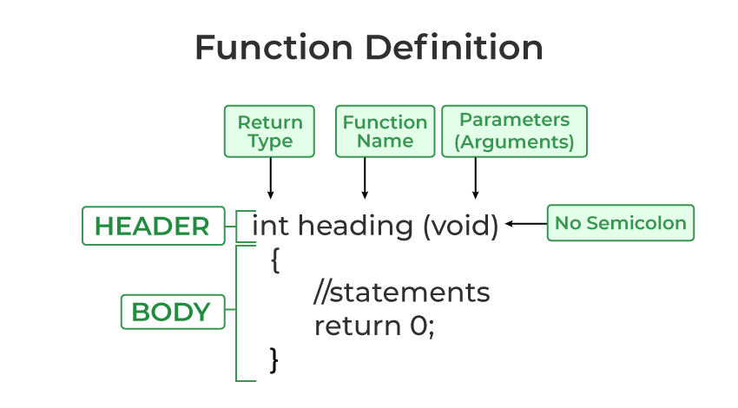
Function Definition
The function definition consists of actual statements which are executed when the function is called (i.e. when the program control comes to the function).
A C function is generally defined and declared in a single step because the function definition always starts with the function declaration so we do not need to declare it explicitly
return_type function_name (para1_type para1_name, para2_type para2_name)
{
// body of the function
}

Slide 6
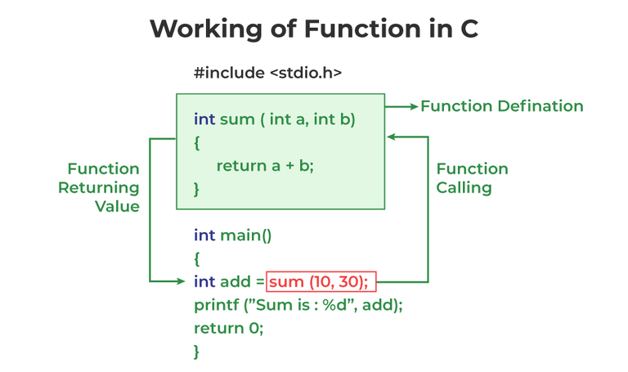
Function Call
A function call is a statement that instructs the compiler to execute the function. We use the function name and parameters in the function call.

Slide 7
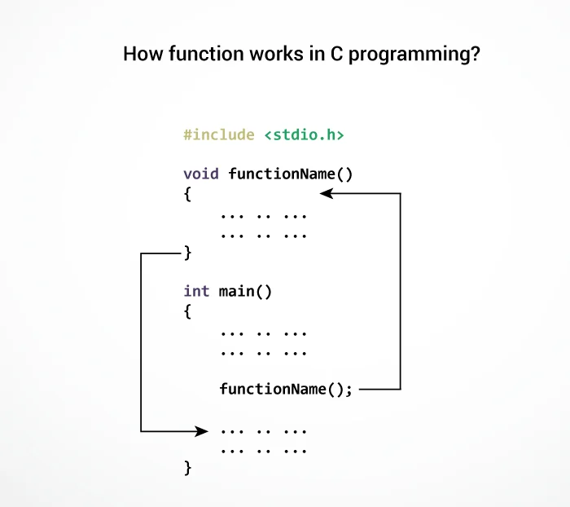

Slide 8
C Programming Functions Without Arguments and no Return Value
#include<stdio.h>
void printName();
void main ()
{
printf("Hello ");
printName();
}
void printName()
{
printf(“helloworld");
}

Slide 9
#include<stdio.h>
void sum();
void main()
{
printf("\nGoing to calculate the sum of two numbers:");
sum();
}
void sum()
{
int a,b;
printf("\nEnter two numbers");
scanf("%d %d",&a,&b);
printf("The sum is %d",a+b);
}

Slide 10
Function without argument and with return value
#include<stdio.h>
int sum();
void main()
{
int result;
printf("\nGoing to calculate the sum of two numbers:");
result = sum();
printf("%d",result);
}
int sum()
{
int a,b;
printf("\nEnter two numbers");
scanf("%d %d",&a,&b);
int c= a+b;
return c;
}
Going to calculate the sum of two numbers:
Enter two numbers 10
24
The sum is 34

Slide 11
program to calculate the area of the square
#include<stdio.h>
int sum();
void main()
{
printf("Going to calculate the area of the square\n");
float area = square();
printf("The area of the square: %f\n",area);
}
int square()
{
float side;
printf("Enter the length of the side in meters: ");
scanf("%f",&side);
return side * side;
}
Going to calculate the area of the square
Enter the length of the side in meters: 10
The area of the square: 100.000000

Slide 12
Function with argument and without return value
#include<stdio.h>
void sum(int, int);
void main()
{
int a,b,result;
printf("\nGoing to calculate the sum of two numbers:");
printf("\nEnter two numbers:");
scanf("%d %d",&a,&b);
sum(a,b);
}
void sum(int a, int b)
{ int c;
C=a+b;
printf("\nThe sum is %d",c);
}
Going to calculate the sum of two numbers:
Enter two numbers 10
24
The sum is 34

Slide 13
Function with argument and with return value
#include<stdio.h>
int sum(int, int);
void main()
{
int a,b,result;
printf("\nGoing to calculate the sum of two numbers:");
printf("\nEnter two numbers:");
scanf("%d %d",&a,&b);
result = sum(a,b);
printf("\nThe sum is : %d",result);
}
int sum(int a, int b)
{ int c;
c=a+b;
return c;
}
Going to calculate the sum of two numbers:
Enter two numbers:10
20
The sum is : 30

Slide 14
C program to find diameter, circumference and area of circle using function
#include <stdio.h>
#include <math.h> // Used for constant PI referred as M_PI
/* Function declaration */
double getDiameter(double radius);
double getCircumference(double radius);
double getArea(double radius);
int main()
{
float radius, dia, circ, area;
printf("Enter radius of circle: ");
scanf("%f", &radius);
dia = getDiameter(radius); // Call getDiameter function
circ = getCircumference(radius); // Call getCircumference function
area = getArea(radius); // Call getArea function
printf("Diameter of the circle = %.2f units\n", dia);
printf("Circumference of the circle = %.2f units\n", circ);
printf("Area of the circle = %.2f sq. units", area);
return 0;
}
/**
* Calculate diameter of circle whose radius is given
*/
double getDiameter(double radius)
{
return (2 * radius);
}
double getCircumference(double radius)
{
return (2 * M_PI * radius); // M_PI = PI = 3.14 ...
}
double getArea(double radius)
{
return (M_PI * radius * radius); // M_PI = PI = 3.14 ...
}

Slide 15
C program to check even or odd using functions

Slide 16
C program to check prime, armstrong, perfect number using functions

Slide 17
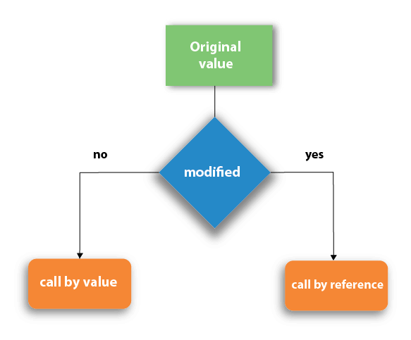
Types of parameter passing in c

Slide 18
Call by value in C
#include <stdio.h>
void swap(int , int); //prototype of the function
int main()
{
int a = 10;
int b = 20;
printf("Before swapping the values in main a = %d, b = %d\n",a,b); // printing the value of a and b in main
swap(a,b);
printf("After swapping values in main a = %d, b = %d\n",a,b); // The value of actual parameters do not change by changing the formal parameters in call by value, a = 10, b = 20
}
void swap (int a, int b)
{
int temp;
temp = a;
a=b;
b=temp;
printf("After swapping values in function a = %d, b = %d\n",a,b); // Formal parameters, a = 20, b = 10
}
Before swapping the values in main a = 10, b = 20
After swapping values in function a = 20, b = 10
After swapping values in main a = 10, b = 20

Slide 19
Call by reference in C
#include <stdio.h>
void swap(int *, int *); //prototype of the function
int main()
{
int a = 10;
int b = 20;
printf("Before swapping the values in main a = %d, b = %d\n",a,b); // printing the value of a and b in main
swap(&a,&b);
printf("After swapping values in main a = %d, b = %d\n",a,b); // The values of actual parameters do change in call by reference, a = 10, b = 20
}
void swap (int *a, int *b)
{
int temp;
temp = *a;
*a=*b;
*b=temp;
printf("After swapping values in function a = %d, b = %d\n",*a,*b); // Formal parameters, a = 20, b = 10
}
Before swapping the values in main a = 10, b = 20
After swapping values in function a = 20, b = 10
After swapping values in main a = 20, b = 10

Slide 20
Difference between call by value and call by reference in c
No. | Call by value | Call by reference
1 | A copy of the value is passed into the function | An address of value is passed into the function
2 | Changes made inside the function is limited to the function only. The values of the actual parameters do not change by changing the formal parameters. | Changes made inside the function validate outside of the function also. The values of the actual parameters do change by changing the formal parameters.
3 | Actual and formal arguments are created at the different memory location | Actual and formal arguments are created at the same memory location

Slide 21
Recursion in C
Recursion is the process which comes into existence when a function calls a copy of itself to work on a smaller problem. Any function which calls itself is called recursive function, and such function calls are called recursive calls. Recursion involves several numbers of recursive calls.

Slide 22
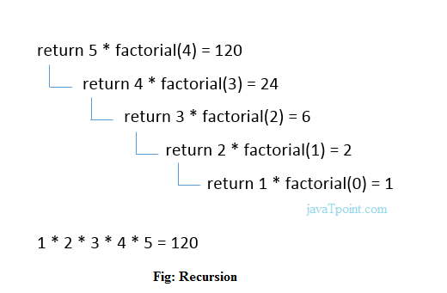
#include <stdio.h>
int fact (int);
int main()
{
int n,f;
printf("Enter the number whose factorial you want to calculate?");
scanf("%d",&n);
f = fact(n);
printf("factorial = %d",f);
}
int fact(int n)
{
if (n==0)
{
return 0;
}
else if ( n == 1)
{
return 1;
}
else
{
return n*fact(n-1);
}
}

